Slide 1

DHAVAL STEEL FORGE

Slide 2
INTRODUCTION
Dhaval Steel Forge is a partnership firm which was established in the year September 2006 by four partners which provides equal contribution to the firm. We are one of the leading manufacturer for forged and turned parts which serve its various valuable customer with zero defect products like Bearing races, Flanges, Auto parts, Gear Rings, Hub, Metal Gaskets etc. in ferrous and alloy steel materials. We are quality conscious and adopt advance technology for the production.
ANNUAL CAPACITY : 4800 MT
RANGE : From 2 kg to 60 kg
MANPOWER : 75 Nos
CERTIFIED : TUV SUD ISO 9001 : 2008.

Slide 3
ORGANIZATION CHART
Partners
Manoj Kanani
Chairman
Rajubhai Kanani / Rajesh Dalsania
Forging Dept.
Manoj Kanani
Annealing Dept.
Dilip Dalsania
Heat Treatment Dept.
Dhaval Limbasiya
General Manager
Operators
Operators
Ajay Markana Production Dept.
P D Rathod
Quality Dept.
Jignesh Vadodariya Forging Supervisor
Operators

Slide 4
VISION & MISSION
TO BE ONE OF THE BEST SUPPLIER IT DEALS WITH IN ALL RESPECT.
TO BE WORLD LARGEST FORGING MANUFACTURER IN NEXT 15- 20 YEARS.
TO ACHIEVE ISO TS :16949 : 2009 CERTIFICATION IN NEXT 3-5 YEARS.
TO HAVE CLIENT LIST OF MINIMUM 50 NOS IN NEXT 5 -10 YEARS.
TO MANUFACTURE ZERO DEFECT PRODUCTION FOR VARIOUS PARTS WITH CONTINUOUS IMPROVEMENT.
TO IMPROVE THE YIELD UPTO MAXIMUM LIMIT FOR ALL PRODUCTS.

Slide 5
LIST OF ESTEEM CUSTOMERS
RAVI TECHNOFORGE PVT. LTD.
ADVANCE TECHNOFORGE. PVT. LTD.
APOLLO TECHNOFORGE. PVT LTD.
PRECISION BEARING PVT. LTD.
MAX PRECISION BEARING PVT. LTD.
MILLENNIUM FORGING PVT. LTD.
TIRUPATI FORGE PVT LTD.

Slide 6
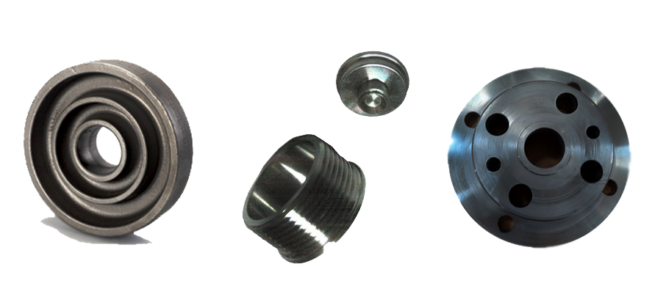
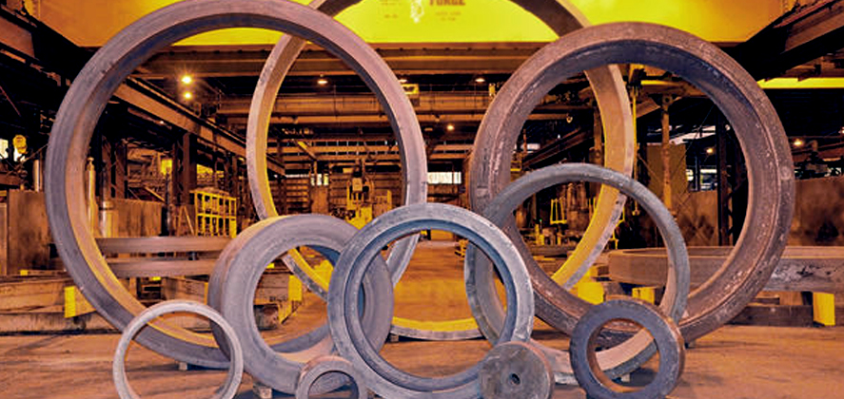
TYPES OF PRODUCTS
BEARING RACES
GEAR BLANKS
FLANGES
HUB
AUTO PARTS
METAL GASKETS
ETC

Slide 7
CAPACITY OF PLANT
FORGING : 2 Lines ( JOGI & DHAVAL STEEL FORGE )
TONNAGE : 400 MT / Month ( 150 MT + 250 MT )
I/P WT : From 1.5 to 60 kgs ( 1.5 to 20 kgs + 5 to 60 kgs )
SIZE : Ø100 to Ø 700 mm
WALL THICKNESS : Up to 150 mm
HEIGHT : Up to 170 mm
FREE CAPACITY : 50 - 60 %

Slide 8
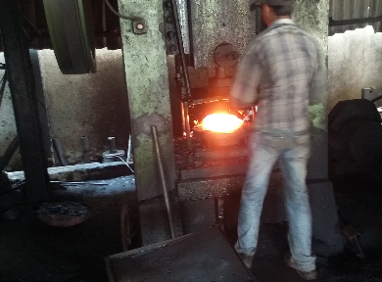
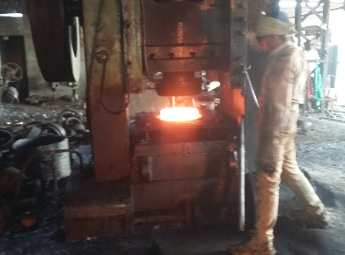
FORGING FACILITY
FORGING CAPACITY – 150 MT / MONTH
I/p Wt. : FROM 1.5 to 20 kg
DIA. : 100 to 300 mm
FORGING CAPACITY – 250 MT / MONTH
I/p Wt. : FROM 5 to 20 kg
DIA. : 250 to 700 mm

Slide 9
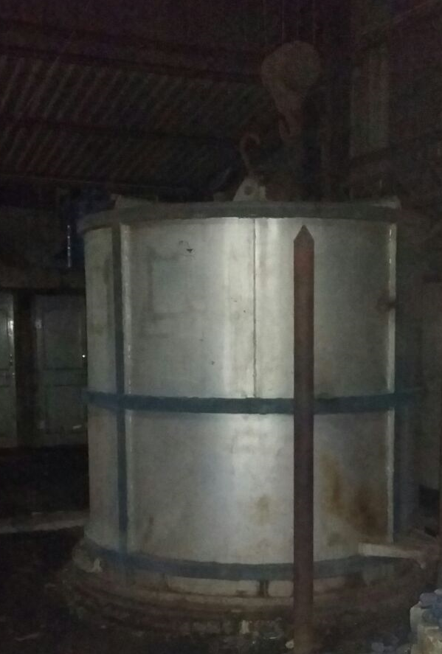
ANNEALING FACILITY
CAPACITY : 250 MT / MONTH
2 : NOS ELECTRIC TYPE FURNACE
3 : NOS PIT TYPE FURNACE
AVG : 12.5 MT PER BATCH / CYCLE

Slide 10
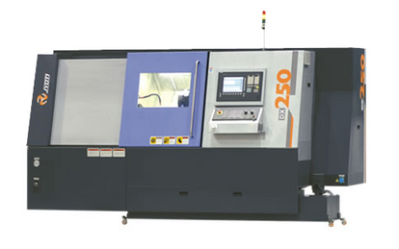
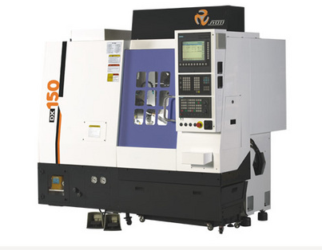
TURNING FACILITY
CAPACITY : 45 k / MONTH
FROM : 100 – 400 mm
CAPACITY : 50 k / MONTH
FROM : 50 – 250 mm

Slide 11
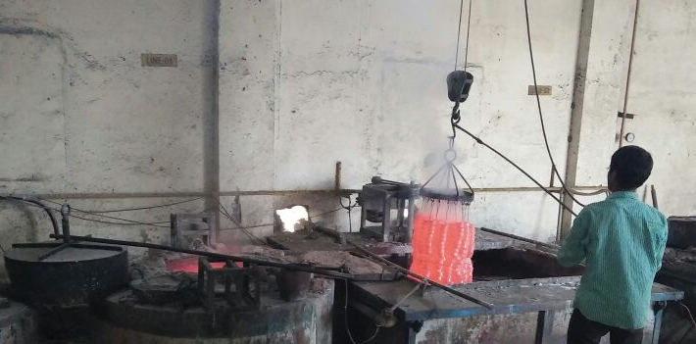
HEAT TREATMENT FACILITY
CAPACITY : 450 MT / MONTH
QTY : 3 Nos.
WT : 65 – 70 kg / Cycle

Slide 12
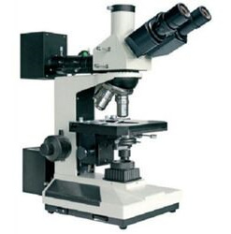
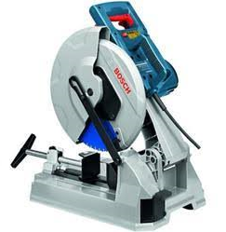
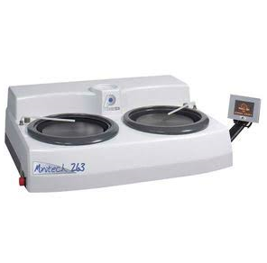
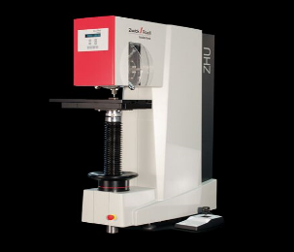
LIST OF TESTING FACILITY
MICROSCOPE CUTTING MACHINE
POLISHING MACHINE HARDNESS TESTER

Slide 13
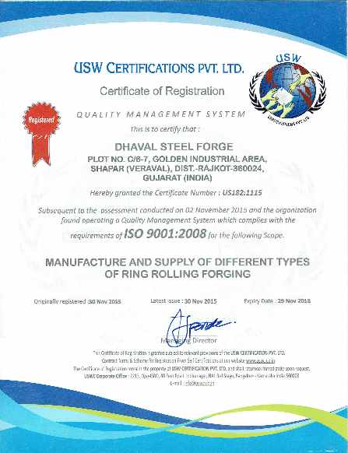
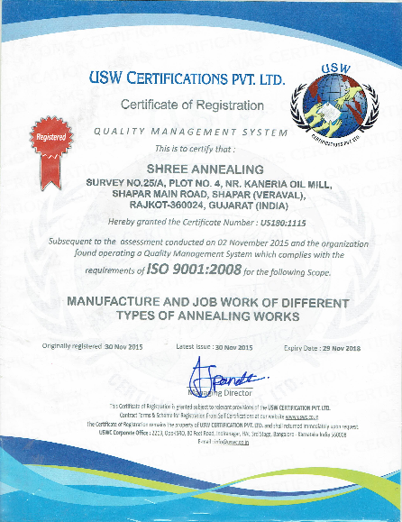
ACHIEVEMENTS

Slide 14

CONTACT US
DHAVAL STEEL FORGE
PLOT NO C / 6-7 , Golden Industrial Area,
Shapar.
Tal : Kotdasangani,
Dis : Rajkot ( GUJARAT ).
Website : www.dhavalsteelforge.in
Email : info@dhavalsteelforge.com

Slide 15

THANK YOU

